Slide 1
In Search of the Kernel of Interpersonal Helping: Fifty Years as a Therapist-Researcher
Robert Elliott
University of Strathclyde

Slide 2
The Present Moment: In General
War in Ukraine
Environmental crisis
Rising social inequality
Increasing political polarisation
Marginalisation of Person-Centred and other Humanistic-Experiential Psychotherapies (HEPs)

Slide 3
The Present Moment: More Personally
72 years old: “New to age as the young are to youth” (George Oppens)
Remembering Mary Kilborn… and so many others who inspired me and who are no longer here:
Carl Rogers, Ted Sarbin, Laura Rice, Gene Gendlin, Pete Sanders (to name a few)
And remembering the last time I spoke at this lecture series, 20 years ago

Slide 4
The Present Moment: In My Research
Recently finished 2 major systematic review projects with challenging/puzzling results:
(1) Latest update of HEP outcome meta-analysis of 90+ studies (Elliott et al., 2021) suggests that Person-Centred Therapy is a bit less effective that CBT (d = -.31), in spite of 5 previous iterations finding no difference (d = -.06)
(2) Two days ago: Review of 45 studies of research on therapist empathic reflections indicates no overall effectiveness (r = 0)
I’ll try to highlight the role of empathic reflection as we proceed & have written extra slides about this, which I probably won’t have time to give.
In the meantime, on with the show!

Slide 5
But First: Let’s Go Back 50 Years…
1972: Started PhD course in clinical psychology at UCLA
Because of my eccentric application essay and my training in humanistic psychology UC Santa Cruz, was assigned to Jerry Goodman
An obscure and eccentric student of Carl Rogers
Community psychologist interested in helping skills training
Amazingly good at empathic reflections

Slide 6
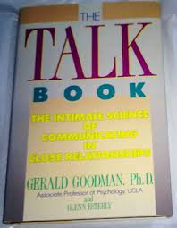

Slide 7
Therapist Response Modes
Jerry proposed a model of therapist response modes:
Basic kinds of responses used by therapists to help clients
Philosophers of language & communication researchers call these speech acts
Central to the field of pragmatics
Each response mode was defined by a form (e.g., paraphrase) and an intention (e.g., communicate understanding of client)

Slide 8
Common Therapist Response Modes & Intentions
Mode/Form | Intention
Question | Gathering Information about client
Advisement | Guiding the client
Reflection | Communicating understanding of client message/experience
Interpretation | Explaining client to themselves/ Giving news to client
Self-Disclosure | Using/Sharing self to help

Slide 9
Testing the Response Mode Model
Because of my fascination with human communication and the philosophy of language, I did minors in Psycholinguistics and the Sociology of Conversation (now known as Conversation Analysis)
This led me to question this model of response mode forms and intentions
Common to different helping skill training programs: e.g., Ivey, Danish, Goodman
I began to wonder: Human communication is wonderfully complex: Do these forms and intentions really correspond so neatly?

Slide 10
Inventing Our Own Version of Interpersonal Process Recall
With two of my fellow Goodman students, Chris Barker & Nancy Pistrang, we developed a method we called “moment by moment analysis”:
Play a recording of a just-completed therapy session back to the client, response-by-response
Ask client what they thought the therapist was trying to do when they said that
Also: While we were at it, ask client to rate how helpful each response was
It was only later that I accidentally came across Norman Kagan’s Interpersonal Process Recall (IPR)

Slide 11
Hypothesis: Reflections Rule!
As Goodman students, we hoped to prove that Reflection
… Is the most effective response mode
And also that it is generally perceived as communicating understanding

Slide 12
Our First Pilot Session
Our new research procedure worked well
But: our hypothesis went down in flames:
A relatively inexperienced therapist offered a steady diet of awkward, shallow reflections
… To a client who because of a previous unhappy therapy experience had acquired an interpersonal allergy to precisely this kind of Reflection
Conclusion: Nothing smells as bad as a bad Reflection to a client who already hates them!

Slide 13
The Kernel of Interpersonal Helping
Somewhere around this time, I was probably enthusing to Jerry Goodman about my latest adventures with IPR when he offered the following empathic conjecture/evocative reflection:
I know you: You’re imagining that one day you’ll be up in the lab doing your research… and out it will pop: the Kernel of lnterpersonal Helping. And you will say, “Oh my God, I’ve found it! It’s the Kernel of Interpersonal Helping!” And you’ll show it to Chris and Nancy, and they’ll say, “You’re right! Brilliant!” Then you’ll show it to me and I’ll agree also. And everyone will say, “You’ve done it!”

Slide 14
Kernel 1.0: Which Response Modes are Most Effective?
Well, yes, that is exactly what I hoped…
And yes, Jerry had offered me a helpful reflection: memorable, accurate, well-timed, … but maybe a bit self-confronting and perhaps a bit deflating
… Based on our pilot client, we already had a pretty good idea that whatever the Kernel was, it probably wasn’t Reflections, or at least Reflections in general

Slide 15
Kernel 1.0: What Response Modes are most helpful? (Elliott, Barker, Caskey & Pistrang, 1982)
Answer: It’s not reflections (single sesson: r = .05; ongoing therapy: r = .04)
Interpretations did best but only in ongoing therapy (r = .25*), not in single session counselling (r = .06)
More importantly: It was clear that for each of the response modes, including Reflection, there were wide variations in helpfulness, with some examples very helpful while others were hindering
Conclusion: Clearly, the Kernel is not to be found in any general response mode

Slide 16
How Clients Perceive Helper Behaviours (Elliott, 1979)
In general, small-to-medium sized associations (r = .1 to .4) between raters’ views of response modes and clients’ views of therapist intentions
Clearly, no strong 1-to-1 associations: Clients don’t always see therapist responses as they look to observers (of therapists)
Example: Hypothesis: Reflections => Communicating Understanding of client message
In single-session counselling, I found the predicted (small) association (r = .26*)
But: in ongoing therapy, Communicating Understanding shifted from Reflections (r = .09) to Acknowledgements (r = .42)

Slide 17
Kernel 2.0: Significant Therapy Events
1976: Fortunately, while carrying out my PhD research study on clients’ experiences of therapist response modes,
I accidentally came upon the following bit of therapy…
Play IPR45 clip

Slide 18
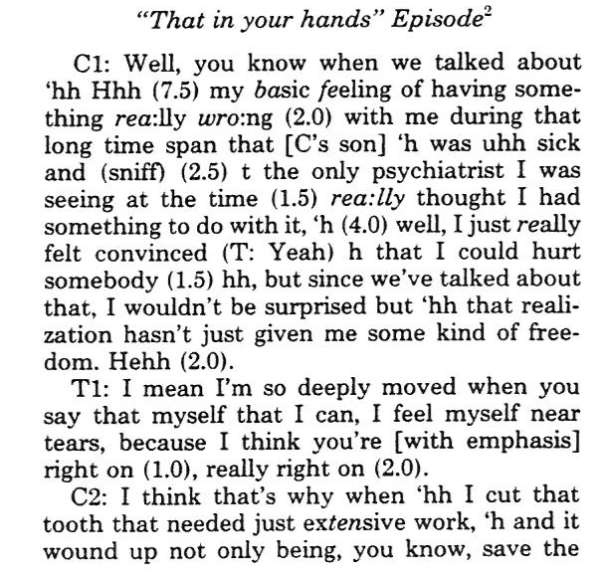

Slide 19
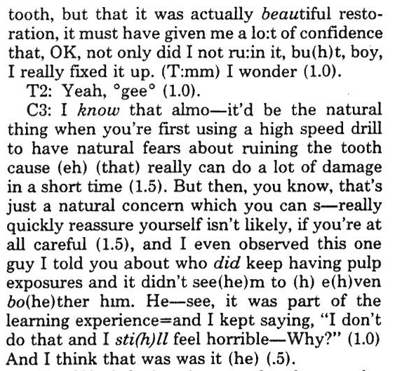

Slide 20
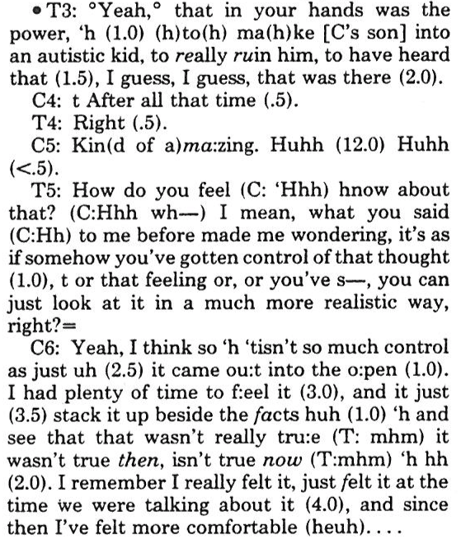
Reflection: collaborative, evocative, empathic conjecture

Slide 22
Significant Events Psychotherapy Research Paradigm
Inspired by this striking therapy event, I then spent the next 15 years of my career figuring out how to identify, assess, and analyse such significant events:
Identification: Helpful Aspects of Therapy (HAT) Form
Assessment: Brief Structured Recall (Elliott & Shapiro, 1987)
Analysis: Comprehensive Process Analysis (CPA; Elliott 1989; Elliott et al., 1994)

Slide 23
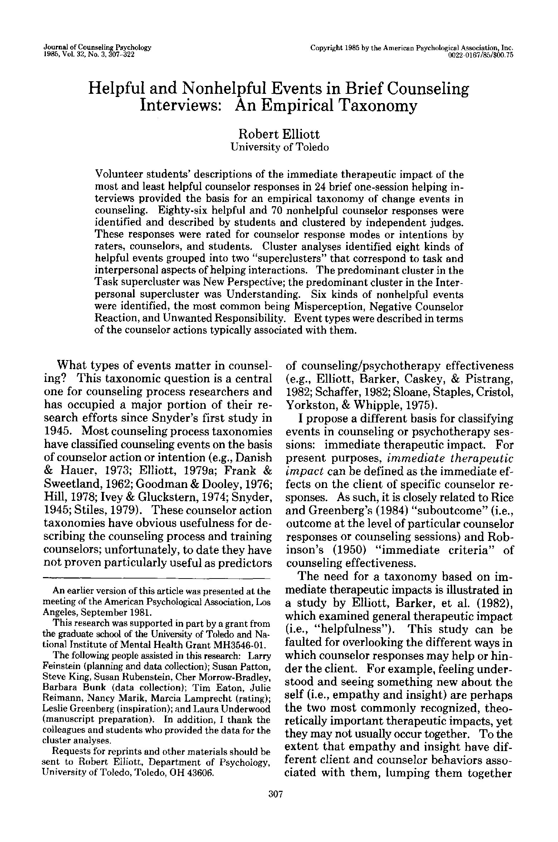
Identifying Significant Events (Elliott, 1985)

Slide 24
Cluster Analysis of Significantly Helpful Events in Brief Counselling Sessions
Laboratory study: 20 min counselling sessions
Wide range of counselling approaches
Significant events identified using Interpersonal Process Recall (IPR):
Clients rated helpfulness for all responses
Asked client to explain the highest and lowest-rated responses.
Client descriptions clustered by 20 raters into 3 – 10 categories of their own choosing

Slide 25
Cluster Analysis of Significantly Helpful Events in Brief Counselling Sessions
Two large clusters: A. Task Cluster:
1. New Perspective (=Insight). Example: Client description: “What she said was confusing, but the general tone added another thought I hadn’t had up to that time.” (Female counsellor asks a series of questions to help male client to think about the impact of his petulant behavior on a female friend he is attracted to.)

Slide 26
Cluster Analysis of Significant Events
A. Task Cluster:
2. Problem Solution: Client: “It showed me one way to improve, one way to go about it.” (End of session: lengthy General Advisement with final tag Question)

Slide 27
Cluster Analysis of Significant Events
A. Task Cluster:
3. Problem Clarification: Client: “She guided me to what the real problem was, how I feel when I’m thinking about what I’m going to say.” (Beginning of session: Multiple-choice empathic conjectures about client’s understanding of the problem)

Slide 28
Cluster Analysis of Significant Events
A. Task Cluster:
4. (Focusing) Awareness: Client: “I was avoiding the issue of how I felt about myself, and he brought it to a point. I was glad he brought it out.” (Simple Exploratory Question)

Slide 29
Cluster Analysis of Significant Events
A. Task Cluster:
5. Understood: Client: “Really giving back to me what I said. It’s nice to know someone can think how you can, that you’re not the only person that’s having a thought.” (Summary Reflection of client’s description of his problem)

Slide 30
Cluster Analysis of Significant Events
A. Task Cluster:
6. Client Involvement: Client: “He was asking my opinion on it and made me want to respond.” (Follow-up question after lengthy General Advisement)

Slide 31
Cluster Analysis of Significant Events
A. Task Cluster:
7. Reassurance: Client: “It backed me up. She felt like what I said was a positive thing.” (Therapist response: Reassurance + Process Reflection: “It’s really nice that you have the poly-sci that you’re excited about. Each time you start talking about it, you start smiling.”)

Slide 32
Cluster Analysis of Significant Events
A. Task Cluster:
8. Personal Contact: Client: “It was like we were not in the session anymore… He was telling me about the way he came from his problem to where he is now. He was trying to made himself human.” (End of session Personal Disclosure)

Slide 33
Conclusion:
No singular Kernel of Inter-personal Helping
Instead: a multiplicity of Kernels

Slide 34
Interpersonal Helping Involves Multiple Change Processes
Task Cluster events can be organized into sequence:
Awareness (= experiences more available to awareness)
=> Problem Clarification
=> Insight (= new perspective)
=> Problem Solution
This understanding led to the development of Stiles’ Assimilation Model

Slide 35
1985-1992: Toledo Experiential Therapy of Depression Study
After a sabbatical at the University of Sheffield, I spent the next 7 years collecting significant events and helping develop what became Emotion-Focused Therapy
I also wrote up the complicated method I’d developed for analysing significant events: Comprehensive Process Analysis (CPA)
I was preparing to spend the rest of my career doing CPAs on EFT events…

Slide 36
Then Something Happened that Took Me Off Track…

Slide 37
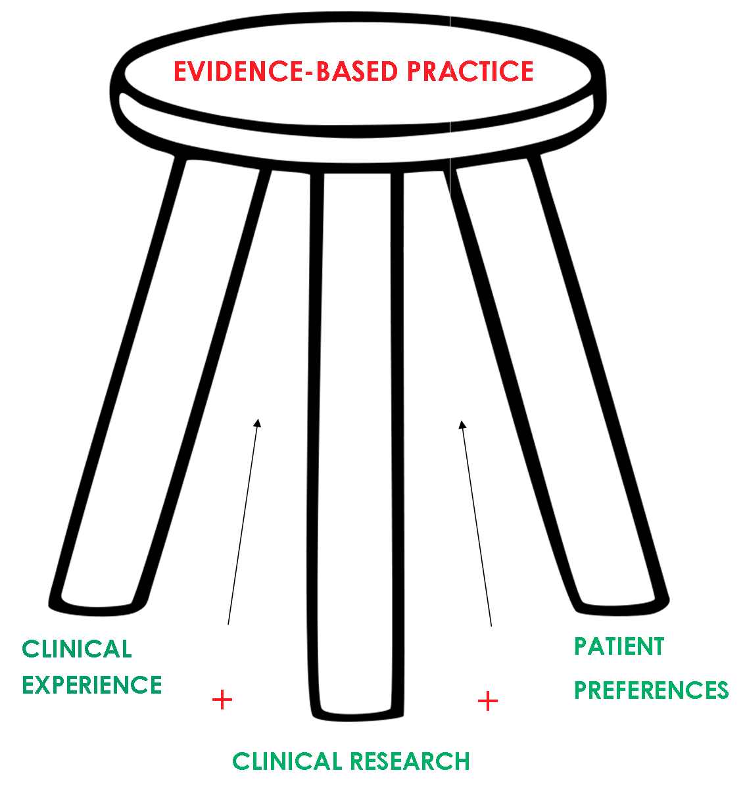
The Evidence-Based Practice Movement
Early 1990’s: American psychologists, worried about the rapid spread of anti-depressant medications, proposed adapting US Federal Drug Administration standards for approving new medications to identifying ”Empirically Validated Treatments” (EVTs)
By 1996, the name had been softened to “Empirically Supported Treatments” (Chambless, 1996)
Later: “Evidence-Based Practice” (EBP; APA, 2006)
1999: National Institute for Clinical Excellence (NICE) established in the UK

Slide 38
Reactions to Evidence-Based Practice Movement
Caught psychodynamic and humanistic therapists/ counsellors by surprise
Many argued that it was biased and unscientific
In fact, there have always been many obvious problems with EBP, but…
Focusing only on challenging validity of EBP movement left us behind during a period of rapid developments
e.g., Improving Access to Psychological Therapies initiative
Notes:
-Put forward by Division of Clinical Psych, Am Psych Assoc.

Slide 39
Result: Humanistic-Experiential Psychotherapy (HEP) Meta-Analysis Project
1992-93: Greenberg, Lietaer & Elliott were invited to contribute a chapter on humanistic-experiential therapies for fourth edition of Bergin & Garfield’s Handbook of Psychotherapy & Behavior Change
We decided to do what we’d always sworn we would never do…
A meta-analysis of all research on HEPs

Slide 41
HEP Outcome Meta-analysis: The First Generation
Greenberg, Lietaer & I fought the process the whole way:
First: We only analysed pre-post effects:
Found: large effects
Bergin & Garfield argued that this didn’t prove that therapy caused these effects
Second: We analysed (a) controlled & (b) comparative studies
Found: 5 times as much change in HEPs vs no-treatment
Found: No difference between HEPs and other therapies
Bergin & Garfield argued that CBT could still be better than HEPs
Third: We broke down types of HEP vs CBT
Found: No difference between Person-Centred and CBT
Found: EFT had larger effects than CBT
Bergin & Garfield stopped arguing with us & accepted the chapter
Better still: We have developed a method for analyzing outcome studies using three lines of evidence

Slide 42
HEP Meta-Analysis Project
Authors | Year | N of studies
1. Greenberg, Elliott & Lietaer (Bergin & Garfield, Handbook of Psychotherapy & Behavior Change, 4th ed.) | 1994 | 37
2. Elliott | 1996 | 63
3. Elliott | 2002 | 86
4. Elliott, Greenberg & Lietaer (in Handbook, 5th ed.) | 2004 | 112
5. Elliott & Freire (Published as Elliott et al in Handbook, 6th ed.) | 2013 (2008 sample) | 191(82 new studies; 67 studies since 2000)
6. Elliott, Sharbanee, Timulak & Watson (in Handbook, 7th ed.) | 2021 | +91 new studies from 2009-2018

Slide 43
Meta-analyses of Humanistic-Experiential Psychotherapy Outcome Research
 | 1947-2008 Meta-analysis |  |  |  | 2009-2018 Meta-analysis
 | K Studies | N Clients |  | M (95% CI) | K Studies | N Clients | M (95% CI)
Pre-Post effect sizes (ES) in HEP samples
Overall (combined follow-up periods):
Primary Outcomes (PO) | -- | -- |  | -- | 94 | 7558 | .86 (.74, .97)
All Outcomes (All) | 199 | 14,032 |  | .93 (.88, 1.04) | 94 | 7376 | .73 (.62, .83)
By follow-up time period:
Post (0 – 1 mo post): | 181 | 13,109 |  | .95 (.86, 1.04) | 91 | 6842 | .86 (.75, .98)
Early follow-up (2–11 mos.) | 77 | 2125 |  | 1.05 (.90,1.20) | 41 | 2161 | .88 (.67, 1.10)
Late follow-up (12+ mos.) | 52 | 2611 |  | 1.11 (.93, 1.29) | 15 | 599 | .92 (.52, 1.31)
By type of HEP (combined follow-up periods)
Supportive-Nondirective | 32 | 704 | .80 (.63, .97) |  | 30 | 1564 | .73 (.55, .92)
Person-Centered | 76 | 10,450 | .95 (.83, 1.04) |  | 18 | 1258 | .98 (.66, 1.29)
Emotion-Focused | 34 | 1138 | 1.21 (1.04, 1.37) |  | 18 | 464 | 1.31 (1.05, 1.58)
Gestalt/Psychodrama |  |  |  |  | 17 | 723 | .78 (.57, .98)
Other HEPs | 53ª | 1605 | .89 (.69, 1.10) |  | 11 | 3521 | .53 (.32, .73)

Slide 44
Meta-analyses of Humanistic-Experiential Psychotherapy Outcome Research
 | 1947-2008 Meta-analysis |  |  |  | 2009-2018 Meta-analysis
 | K Studies | N Clients |  | M (95% CI) | K Studies | N Clients | M (95% CI)
Controlled ES: HEPs vs. untreated participants
Controlled effects overall | 62 | 4102 | .76 (.64, .88) |  | 21 | 1519 | .88 (.55, 1.20)
Controlled RCTs | 31 | 1146 | .76 (.66, .86) |  | 14 | 848 | .98 (.51, 1.44)
HEP pre-post | 59 | 2144 | .92 (.83, 1.10) |  | 20 | 621 | .95 (.65, 1.26)
Untreated Control pre-post | 53 | 1958 | .15 (.09, .22) |  | 20 | 648 | .09 (-.03, .21)
Comparative ES: HEPs vs. NonHEPs
Comparative studies overall | 135 | 13485 | .00 (-.07, .06) |  | 63 | 16266 | -.08 (-.21, .04)
RCTs only | 113 | 5552 | -.03 (-.11, .06) |  | 56 | 6931 | -.07 (-.21, .07)
HEP pre-post | 97 | 5975 | .93 (.82, 1.05) |  | 62 | 5876 | .76 (.62, .88)
NonHEP pre-post | 122 | 6985 | .98 (.88,1.09) |  | 62 | 10262 | .82 (.65, 1.00)

Slide 45
Meta-analyses of Humanistic-Experiential Psychotherapy Outcome Research
 | 1947-2008 Meta-analysis |  |  |  | 2009-2018 Meta-analysis
 | K Studies | N Clients |  | M (95% CI) | K Studies | N Clients | M (95% CI)
Comparative ES: HEPs vs. Specific NonHEPs
HEPs vs. CBT
Overall | 77 | 9041 | -.17 (-.25, -.09) |  | 36 | 13,785 | -.26 (-.37, -.15)
RCTs | 66 | 2833 | -.17 (-.27, -.07) |  | 32 | 4641 | -.26 (-.36, -.16)
HEP vs. non-CBT
Overall | 58 | 4444 | .17 (.08, .27) |  | 27 | 2481 | .19 (-.04, .43)
RCTs | 47 | 2719 | .15 (.03, .28) |  | 24 | 2290 | .24 (-.03, .51)
Different HEPs vs CBT
PCT vs. CBT | 22 | 6956 | -.06 (-.11, -.01) |  | 10 | 2305 | -.31 (-.55, -.08)
Supportive-nondirective vs. CBT | 37 | 1466 | -.31 (-.45, -.17) |  | 23 | 2465 | -.31 (-.44, -.18)
Comparative ES: More vs less intensive/ process guiding HEPS
Overall | 9 | 294 | .14 (-.21, .50) |  | 6 | 640 | .18 (-.12, .48)

Slide 46
Summing up the HEP Meta-analysis Project
1. Inclusive and Comprehensive: We use all the evidence:
Mantra: “The Facts are Friendly” –Carl Rogers
All analyzable studies that met inclusion criteria
All outcome measures (Generations 1 – 5)
Generation 6: primary outcome measures
All post-therapy & follow-up assessment
Reduces inevitable bias that comes with picking and choosing studies based on methodological quality

Slide 47
Summing up the HEP Meta-analysis Project
2. Three lines of converging evidence:
Pre-post effects: How much do clients change over therapy?
Answer: A lot
Controlled effects: Do clients use therapy to cause themselves to change?
Answer: Yes
Comparative effects: Are HEPs as effective as CBT?
Answer: It’s complicated…In general, yes , but with exceptions

Slide 48
Getting Back on Track: Return to the Romance of Significant Therapy Events
A couple of years ago I suddenly realised that in all the politics and evidence I’d lost track of something vital: Significant Therapy Events
Significant events connect me to my practice as a therapist, and to the process of transformation in therapy
I became an EFT therapist in pursuit of moments of emotional transformation

Slide 49
Let’s Finish by Going Back a Couple of Significant Events Involving Empathic Reflections

Slide 50
Example 1: Empathic Reflection in Counselling Training Large Group
As I was preparing this lecture, I received an email from one of our recent MSc students:

Slide 51
1
Hi Robert,
I just wanted to share a moment that I shared with you that I fondly remember as clear as day. I rarely spoke up in Large Group PPD (I think I only spoke up 2-3 times during out throughout the MSc) but this one time I did, I brought up pain and how hard it was to just experience so much in your life.

Slide 52
Reflections: Empathic Formulation + Process Reflection
2
And you said something to me that sticks with me to this day: "There is so much you hide behind that smile. And there it is again, to hide your pain". I don't know if you remember that moment but it’s one of my most treasured memories in the course because I think it was the first time I truly felt seen.

Slide 53
Example 2: “Bethany” (SA601)
29, female, Scottish, married, 1-year-old daughter
My last social anxiety client
Severe social anxiety, since age 14: centred around informal social interactions and close personal relationships
Saw self as awkward and damaging to others
Received 19 sessions in 2016; good outcome case
Case example in Elliott & Greenberg (2021), Emotion-focused Counselling in Action
Highest rated significant event on HAT Form: Session 17
Helpfulness Rating: 8.7 (=slightly less than “Extremely Helpful”)

Slide 54
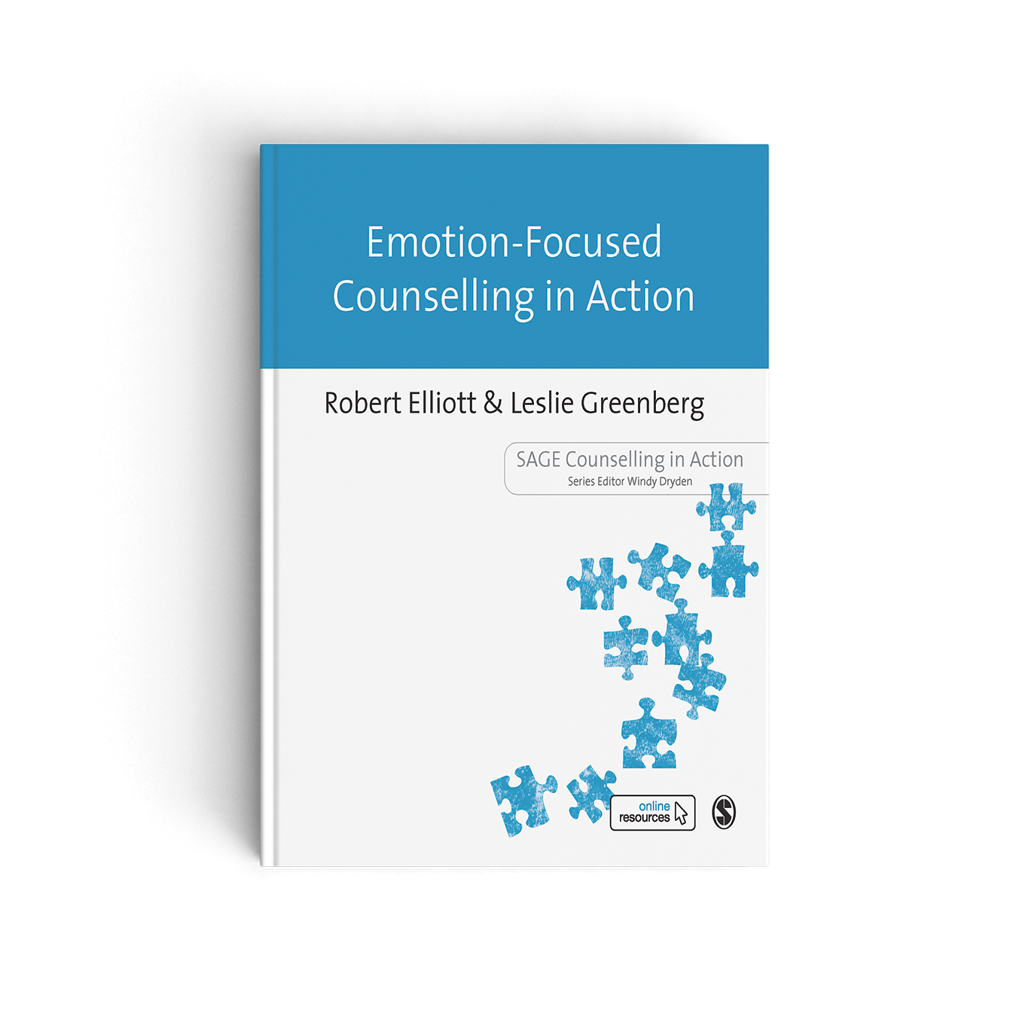
Robert Elliott and Leslie Greenberg
March 2021
ISBN: 9781446257241
See order information at end of slides…

Slide 55
Significant Event: Session 17: “I don’t have to be scared about being myself”
Most helpful: I think somewhere near the end I suddenly realized that I can’t always account for other people’s shortcomings/problems they are experiencing.
What made it helpful: This led me to the realization that some of my thought processes are starting to change. Whereas before I immediately assumed that I was completely to blame, I was now starting to think that maybe sometimes it could be something with the other person. Thereby starting to let go of my belief that I destroy everything/everyone.

Slide 56
Transcript: SA601, Session 17 43:14 – 45:35
T1: … So how’s it working today here with this? ºIt feelsº (pause)
C2: I think it’s, good, yeah, like, It feels more like, I don’t have to be so scared?
T2: “I don’t have to be so scared of thinking I’m OK?” [=Evocative Reflection/empathic conjecture; inaccurate]

Slide 57
Transcript: SA601, Session 17 43:14 – 45:35
C3: I don’t have to be so scared about, being myself
T3: Oh, OK, got it, OK, right [vigorous head nods]
C4: Because, like I have been able to sometimes, like say what I needed to say in a way that was, easier for people to hear
T4: OK, OK, so I can still be myself, but I can do it in a way that people can hear easier / OK
C5: Yeah, and it’s good to remind myself that, like, (pause), that I’m not just, hurting people

Slide 58
Transcript: SA601, Session 17 43:14 – 45:35
T5: [repositions chair] That I’m not just hurting people, yeah, yeah, yeah. I’m not just going around hurting people, [T looking down to floor] because I’m sadistic or something (C: Yeah). I don’t take pleasure in hurting people
C6: No, so then that feels more like, that’s true, so I can relax a little bit more
T6: Right, I can relax in life a bit more (C: Yeah) And you started- [to say]
C7: Does that make sense?

Slide 59
Transcript: SA601, Session 17 43:14 – 45:35
T7.1: Yes [hunched over, nodding rapidly and smiling] I can relax in life a bit more, because I’ve come to understand that my intentions are fundamentally good (C: Uh-huh) even when I say things, when they come out not the way I would prefer them to come out, and someone takes offense, or is knocked back [enacts being knocked back] a little bit, I see that and then I try to (C: yeah) make it better (C: m-hm).

Slide 60
Transcript: SA601, Session 17 43:00 – 45:35
T7.2: It’s like, we can’t always, um, respond every moment the way we wish we could (C: Yeah) the way that would make us proud of ourselves [C smiles and nods] we can’t always do that, so I guess, we do our best, it’s like giving ourselves credit for doing our best (C: Yeah) in the circumstances at that moment (C: Yeah) [=Empathic Affirmation]
…

Slide 61
Transcript: SA601, Session 17 45:57 – 46:20
…
C8: Yeah and you can’t always account for other people’s (T: reactions) right
T8: Uh-huh, you can’t control how other people are going to take it. [=Empathic Reflection] [C: laughs] 46:20

Slide 62
“In My End is My Beginning” –Mary Queen of Scots
This significant event turns out to be eerily similar to the first significant I collected 40 years:
Both clients presented with severe anxiety, which was ruining their ability to function in their lives
In both cases, the therapeutic work had traced the origin of the anxiety back to their having been told by authority figures (a psychiatrist, a father) that they were responsible for damaging someone important to them (a child, a mother)

Slide 63
In My End is My Beginning
In both events, the client takes a moment to pause, late in therapy, in order to reflect back over the course of the therapy, and suddenly realizes, like a mountain climber, just how far she has come
In both events, the therapist primarily witnesses to the client’s transformation, providing a high level of empathic reflections and presence to validate it
Both events are thus moments in which the outcome of therapy becomes present and self-evident to both client & therapist

Slide 64
In My End is My Beginning
There is now a small literature on such Progress Events:
Miguel Goncalves et al: Performing Change Innovative Moments
Lynn Angus et al: Unexpected Outcome Stories
We can also see the important role of therapist Empathic Reflections in these moments, in spite of the null finding I shared at the beginning of this presentation
Suggesting that this is one of the crucial moments in which empathic reflections are likely to be highly effective
I’m pretty confident (p < .01) that this is one of the Kernels of Interpersonal Helping

Slide 65
In My End is My Beginning
You could say that these are just echoes of previous major therapeutic work
And yet it seems to me that there is great power in such moments
In which we allow ourselves to really see how we’ve changed
And feel at the deepest level how we are transformed
Beyond any need for politics or outcome measures
… And I think it’s also true that these moments over the past 50 years, and my attempts to learn how to capture, understand and communicate them to others…
That these are also significant events in my life as a person-centred/experiential therapist and researcher.

Slide 66
Thank You!
…To all my colleagues and friends who welcomed me here 16 years ago
… To all my students here and elsewhere who challenged me with their curiosity and questions
… To all my clients who shared their deepest feelings and inspired me to become a better therapist
… And to all of you watching this tonight, here and online

Slide 67
Robert Elliott and Leslie Greenberg
March 2021
RRP: £23.99
ISBN: 9781446257241
TO ORDER AT 25% DISCOUNT
1. Go to www.sagepub.co.uk
2. Add your book(s) to shopping basket
3. Enter discount code at checkout UK22AUTHOR
Offer valid till 31/12/2022 and cannot be used in conjunction with another offer.

Slide 68
Questions?

Slide 69
Bonus Slides

Slide 70
Speculations about those perplexing findings
Elliott et al, 2021: PCT vs. CBT (r = -.31)
1. Smaller sample of studies & clients (results less reliable, easier to skew)?
2. CBT has gotten more effective?
3. CBT researchers have gotten better at skewing the results in their favour?
4. Recent research is focused on more challenging client populations (e.g., coping with chronic medical conditions) that PCT is not so good with (or is less developed for)?

Slide 71
Conclusions of Empathic Reflection review (Elliott, Bohart, Larson, Smoliak & Muntigl, almost submitted)
1. The sheer presence of Empathic reflections is not effective in itself (r = 0)
2. Empathic reflections should not be delivered as one’s only response, or in a nonresponsive manner regardless of client circumstance, interest or need.
3. Empathic reflections are more likely to be effective if they are based on and express genuine empathy for the client.
4. Empathic reflections can be neutral, effective or even hindering, depending on the circumstances, how they are delivered, and whether the therapist can adapt them if they miss the client’s meaning.

Slide 72
Conclusions of Empathic Reflection review (Elliott, Bohart, Larson, Smoliak & Muntigl, almost submitted)
5. Simple reflections of client content are in general likely to be slightly hindering, possibly because they can be annoying, repetitive or seem ingenuine.
6. Reflections of client desire for change and reasons for change are in general likely to be slightly helpful (cf. Motivational Interviewing).
7. Reflections that summarize what the client (and therapist) have talked about are likely in general to be slightly helpful, possibly formulating client experience into narratives about their experiences.
8. It is useful or even essential for therapists to attend to empathic opportunities in sessions, e.g., when clients are engaged telling about their troubles and expressing their feelings about these troubles.

Slide 73
Why are the Effects of Empathic Reflections so Small or Non-existent? Possible Explanations:
1. Filler: Reflections are therapeutically inert filler
2. Nudges: Reflections are small opportunities for clients to explore further, generally imperceptible in their effects, which are indirect & contextual
3. Significant Reflections swamped. Some reflections are very helpful but these are rare and are cancelled out by bad reflections
4. Quality over mode: Empathy, timing & manner are more important than response mode

Slide 74
References - 1
Elliott, R. (1979). How clients perceive helper behaviors. Journal of Counseling Psychology, 26, 285-294.
Elliott, R. (1983). "'That in your hands...': A comprehensive process analysis of a significant event in psychotherapy. Psychiatry, 46, 113-129.
Elliott, R. (1985). Helpful and nonhelpful events in brief counseling interviews: An empirical taxonomy. Journal of Counseling Psychology, 32, 307-322.
Elliott, R. (1998). Editor’s Introduction: A Guide to the Empirically-Supported Treatments Controversy. Psychotherapy Research, 8, 115-125.
Elliott, R., Barker, C.B., Caskey, N., & Pistrang, N. (1982). Differential helpfulness of counselor verbal response modes. Journal of Counseling Psychology, 29, 379-387.
Elliott, R., & Greenberg, L.S. (2021). Emotion-Focused Counselling in Action. Sage.
Elliott, R., James, E., Reimschuessel, C., Cislo, D., & Sack, N. (1985). Significant events and the analysis of immediate therapeutic impacts. Psychotherapy, 22, 620-630.

Slide 75
References -2
Elliott, R., & Shapiro, D. A. (1988). Brief Structured Recall: A more efficient method for identifying and describing significant therapy events. British Journal of Medical Psychology, 61, 141-153.
Elliott, R., Shapiro, D.A., Firth-Cozens, J., Stiles, W.B., Hardy, G., Llewelyn, S.P, & Margison, F. (1994). Comprehensive process analysis of insight events in cognitive-behavioral and psychodynamic-interpersonal therapies. Journal of Counseling Psychology, 41, 449-463.
Elliott, R., Watson, J., Timulak, L., & Sharbanee, J. (2021). Research on Humanistic-Experiential Psychotherapies. In M. Barkham, W. Lutz, & L Castonguay (eds.). Garfield & Bergin’s Handbook of Psychotherapy & Behavior Change (7th ed.; pp. 425-472). New York: Wiley.
Greenberg, L., Elliott, R., & Lietaer, G. (1994). Research on experiential psychotherapies. In A.E. Bergin & S.L. Garfield (Eds.) Handbook of psychotherapy and behavior change (4th ed., pp. 509-539). New York: Wiley.
Llewelyn, S.P., Elliott, R., Shapiro, D.A., Firth, J., & Hardy, G. (1988). Client perceptions of significant events in prescriptive and exploratory periods of individual therapy. British Journal of Clinical Psychology, 27, 105-114.

Slide 76
Contact
robert.elliott@gmail.com

